Slide 1


UNIVERSITY INSTITUTE OF ENGINEERING Academic Unit V Bachelor of Engineering (Computer Science & Engineering) Biology For Engineers 23SZT148
Bio Signals/ Biomedical Signals
Basic Medical Instrumentation system
DISCOVER . LEARN . EMPOWER

Slide 2
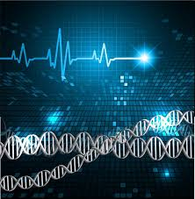
Course Objective
This subject is designed to impart fundamental knowledge on basic and emerging fields of biology like bioinformatics.
It is designed to impart knowledge that how to apply basics of biology in engineering.
https://images.app.goo.gl/pfWfHfCFP56qo7wC7

Slide 3
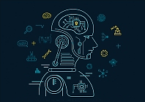
Course Outcome
CO Number | Title | Level
CO1 | Identify the biological concepts from an engineering perspective. | knowledge
CO2 | Development of artificial systems mimicking human action. | Understand
CO3 | Explain the basic of genetics that helps to identify and formulate problems | Analyze
CO4 | Apply knowledge of measurement system, biomedical recording system and biosensors to excel in areas such as entrepreneurship, medicine, government, and education. | Apply
CO5 | Integrate biological principles for developing next generation technologies, | Create
Will be covered in this lecture
https://images.app.goo.gl/5obqqxo93P2UBmdU6

Slide 4

SYLLABUS
Unit-2 | Biosensors and measurement system | Contact Hours: 15
Chapter 1 Medical Instrumentation Chapter 2 Measurement System Chapter 3 Biological Sensor | Medical Instrumentation: Sources of biomedical Signals, Basic medical Instrumentation system, Performance requirements of medical Instrumentation System, Microprocessors in Medical instruments, PC base medical Instruments, General constraints in the design of medical Instrumentation system, Regulation of Medical Devices. Measurement System: Specification of instruments, Statics & Dynamic characteristics of medical instruments, Classification of errors. Statistical analysis, Reliability, Accuracy, Fidelity, Speed of responses, Linearization of technique, and Data Acquisition System. Biological sensors: Sensors/ receptors in the human body, basic organization of the nervous system- neural mechanism, Chemoreceptor: hot and cold receptors, sensors for smell, sound, vision, Ion exchange membrane electrodes, enzyme, glucose sensors, immunosensors, & biosensors & applications of biosensors.

Slide 5
Medical Instrumentation
Bio Signals/ Biomedical Signals
Basic Medical Instrumentation system

Slide 6
Bio Signals/ Biomedical Signals

Slide 7
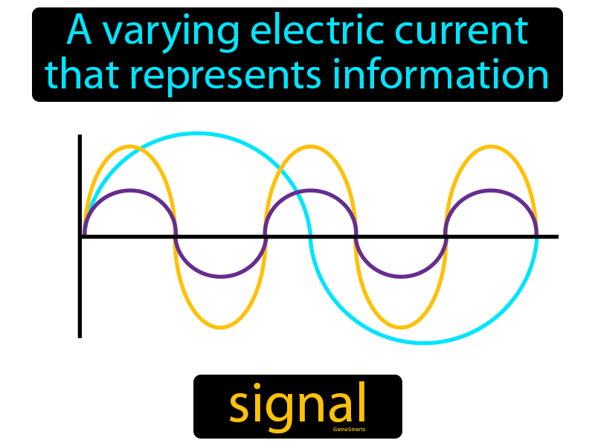
What is Signal ?
A fluctuating quantity whose variations represent information.
Signals are represented mathematically as functions of one or more independent variables.
Examples voltage, current, electric field strength, light, sound, etc.
Function that conveys information.

Slide 8
Bio Signals
Bio signals means the signals which are generated in biological systems only.
The electrical, chemical, and mechanical activity that occurs during these biological event often produces signals that can be measured and analyzed.
Bio signals can be measured directly from their biological source, but often external energy is used to measure the interaction between the physiological system and external energy.

Slide 9
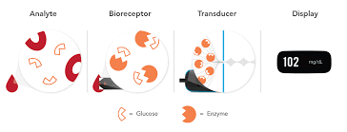
Biological system + Instrument (Biosensor)
Bio signals
Chemical being identified and measured
Recognize analyte
Convert signals
Enzyme- Glucose oxidase----Convert glucose into gluconic acid

Slide 10
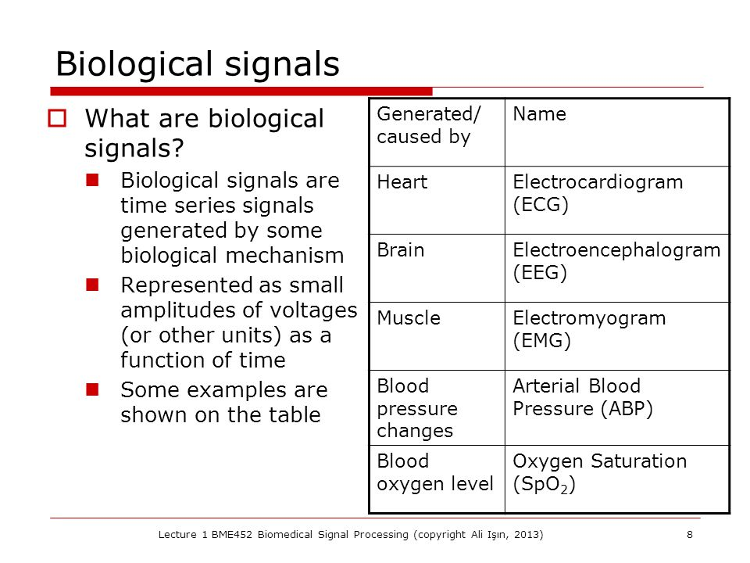
Instruments
Bio signals

Slide 11
Biomedical Signals
Biomedical signals--- those signals primarily for extracting information on a biological system under investigation.
Biomedical signals are observations of physiological activities of organisms, ranging from gene and protein sequences, to neural and cardiac rhythms, to tissue and organ images
Bio signals-------Useful for medical diagnosis.
(e.g., Physician who uses a stethoscope to listen to a patient's heart sounds or with the aid of technologically advanced biomedical instruments)

Slide 12
How biomedical signals are generated ?
Biomedical signals are generated by biological activity in the human body.
Action of living tissues----bioelectric potentials generate multiple electric signals----measured.
Human body is composed of living tissues that can be considered as a power station.

Slide 13
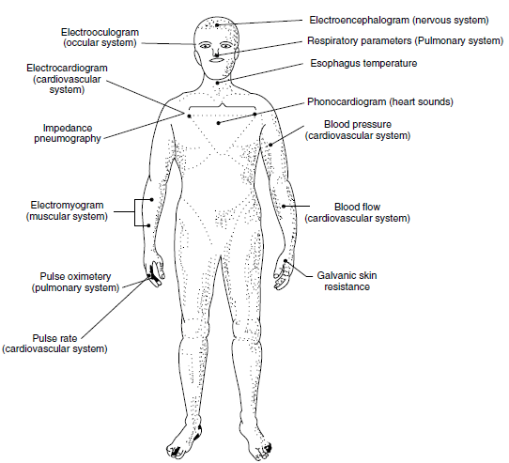
Biomedical signals/Physiological signals are classified according to where they originate from within the body

Slide 14
Sources of Biomedical Signals
EMG Electromyogram- Signals from muscles
ECG Electrocardiogram- Signals from Heart
ERG Electroretinogram- Signals from retina of an eye
EOG Electrooculogram- Signals from cornea and retina of an eye
MEG Magneto encephalogram- Signals from brain using magnetic field
USG Ultra sonogram- Imaging from ultra sound reflection from the internal organs of the body
EEG Electroencephalogram- Signals from brain

Slide 15
Classification of Biomedical Signals
Bio mechanical Signal- These signals are generated due to some mechanical function of a physiological system(Movement of heartbeat, chest)
Bio chemical Signal- Signal generated by certain chemicals (Changes in cell metabolism)
Bio magnetic Signal- Extremely weak magnetic fields are produced by various organs such as the brain, heart, lungs
Bio optical signal- These signals are generated as result of optical functions of the biological system
Bio electric Signal- The electric field generated by the action of many cells constitutes the bioelectric signal (ions- Na, Ca)

Slide 16
Importance/Applications of Bio signals
Following data acquiration, biological signals are analyzed in order to retrieve useful information
Bio-signals monitoring is a medical intervention defined as the act for collection and analysis of cardiovascular, respiratory, and body temperature data, in order to determine and prevent complications
Diagnosis of diseases
Patient monitoring
Biomedical research
The bio-signals values situated in a range over normal values occur in case of diseases, and an alteration of vital signs is used to evaluate a patient's progress

Slide 17
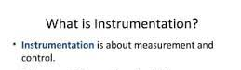
Basic Medical Instrumentation System

Slide 18
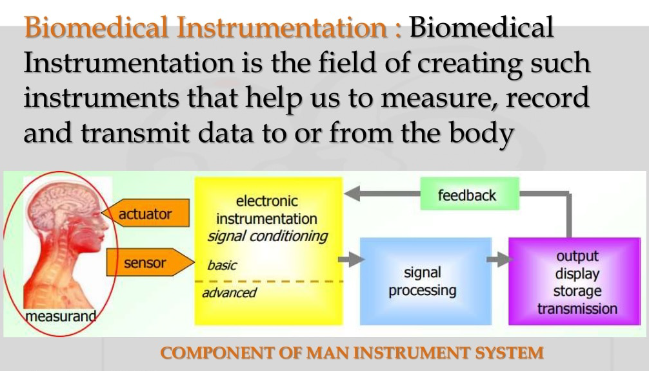
Biomedical instrumentation and engineering is the application of knowledge and technologies to solve problems related to living biological systems
Biomedical Instrumentation
Biomedical Instrumentation is the field of creating such instruments that help us to measure, record and transmit data to or from the body or biological system
Components

Slide 19
It emphasizes the measurement of all the variables in the body for the use of diagnosis and therapy
Biomedical Instrumentation
It is a cross-disciplinary field of study comprising: Engineering, Biology, Chemistry and Medicine

Slide 20
Basic Objectives of Instrumentation System
Information Gathering
To measure natural phenomena and other variables
Diagnostic
Measurement are made to help in the detection and the correction of some disease.
Evaluation
Measurement are used to evaluate the results.
Monitoring
Instrumentation is used to monitor some process in order to obtain information about the state of the system being measured
Control
Instrumentation is sometime used to automatically control the operation of a system

Slide 21

COMPONENTS/ FUNCTIONAL PARTS OF BIOMEDICAL INSTRUMENTATION
Basic Medical Instrumentation System
The basic components of this system are the same as in any other instrument system
The only difference is in this case the living human being considered as subject
The main components are
Measurand/Subject (human being)
Control device
Stimulus
Transducers/ Sensor
Signal conditioning equipment
Display equipment
Recording data processing unit
MST
SDRC

Slide 22
Any medical instrument consists of the following functional basic parts:
Measurand
The measurand is the physical quantity measured by instrumentation.
Transducer/ Sensor/ Role of transducer
The transducer is a device converts one form of energy to another form usually electrical energy.
The transducer produces a usable output depending on the measurand.
Human body acts as the source for measurand, and it generates bio-signals.
Example: body surface or blood pressure in the heart
For example, the piezoelectric sensor which converts mechanical vibrations into the electrical signal.
Stimulus / Signal
Type of bio signal- visual ( a flash of light), auditory ( a tone)
For response--stimulus is required
The sensor is used to sense the signal from the source.

Slide 23
Display
Signal Conditioner
It is used to provide a visual representation of the measured parameter or quantity.
Example: Monitor of PC to see the data.
Used to convert the output of transducer into an electrical value.
Generally, signal conditioning process includes amplification, filtering, analogue to digital and Digital to analogue conversions.
Signal conditioning improves the sensitivity of instruments.
Converts one type of electronic signal into a another type of signal.

Slide 24
Recording/ Data Storage and Data Transmission
Data storage is used to store the data and can be used for future reference.
Recent days Electronic Health records are utilized in hospitals.
Control Device
It is necessary to have automatic control of the transducer, stimulus or any part of the man instrument system, a control system is incorporated
This system usually consists of a feedback loop in which part of the output from signal conditioning equipment or display equipment is used to control the operation of the system

Slide 25
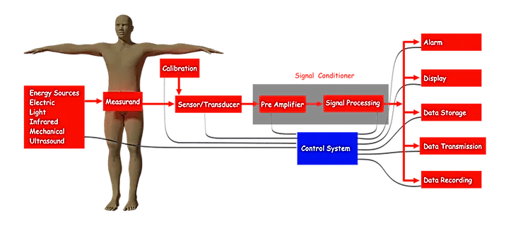
4
5
Measurand
6
2
1
3
7

Slide 26
APPLICATIONS/ Biomedical instrumentation is important
As the medical field is emerging, the area of Biomedical Engineering is an expanding field.
Bio-medical engineering is aimed at keeping people healthy and helping to cure them when they are ill.
Biomedical instrumentation and engineering is the application of knowledge and technologies to solve problems related to living biological systems.
Biomedical Instrumentation helps physicians to diagnose the problem and provide treatment.
It involves diagnosis, treatment and prevention of disease in human.

Slide 27
REFERENCES
C. R. Balamurugan and D. Periazhaagar Basics of Biomedical Instrumentation. Magnus Publications, Chennai ISBN: 978-81-939626-7-1
Gupta, P.K.. Cytology, Genetics and Molecular Biology, Rastogi Publishers, Meerut, 1993.
Roit I.M., Brostoff J. and Male D. Mosby .Immunology (6 th Edition) by, An imprint of Elsevier Sci Ltd., 2002.
G. Webster , Medical Instrumentation: Application And Design, 3rd edition ,Wiley Publishers
D Reddy, Biomedical Signal Processing, Tata Mcgraw Hill Publications.
Sergio Cerutti Advanced Methods of Biomedical Signal Processing, Oxford Publications.
B. Jacobson, J.G. Webster, Medical and Clinical Engineering, Prentice Hall, International.
Cromwell, Biomedical Instrumentation and Measurements, Prentice Hall, International.
R.S. Khandupur, Handbook of Biomedical Instrumentation, - Tata McGraw Hill
Leslie Cromwell, Fred J. Weibell, Erich A. Pfeiffer, "Biomedical Instrumentation and Measurements", Pearson Education.
https://nptel.ac.in/courses/121/106/121106008/
https://www.utoledo.edu/engineering/bioengineering/undergrad/prospective/whatisbioe.html#:~:text=Bioengineering%20is%20the%20application%20of,health%20care%20and%20other%20fields
https://i.pinimg.com/originals/68/c9/30/68c930e95113ceb2e3dfc9de2f164680.png
https://youtu.be/FBUpnG1G4yQ

Slide 28

THANK YOU

